Slide 1
BAGGING & BOOSTING

Slide 2
BAGGING (Bootstrap Aggregation)
1. What is Bagging
Bagging is an ensemble learning technique that trains multiple models independently on different bootstrap samples and combines their predictions to improve stability and accuracy.

Slide 3
2. Purpose
To reduce variance and overfitting in high-variance models (especially Decision Trees).

Slide 4
3. Why it is Used
Stabilizes unstable models
Reduces overfitting
Improves generalization
Parallelizable

Slide 5
4. How Bagging Works (Algorithm)
Create multiple bootstrap samples (sampling with replacement)
Train a base learner on each sample
Make predictions independently
Aggregate results:
Classification → majority vote
Regression → mean

Slide 6
5. Formula
Classification:
y^=mode(h1(x),h2(x),...,hn(x))
Regression:
y^=1/n∑hi(x)

Slide 7
6. Technical Details
Ensemble type: Parallel
Reduces variance, not bias
Base models are independent

Slide 8
7. Parameters
Number of estimators
Base estimator type
Bootstrap size

Slide 9
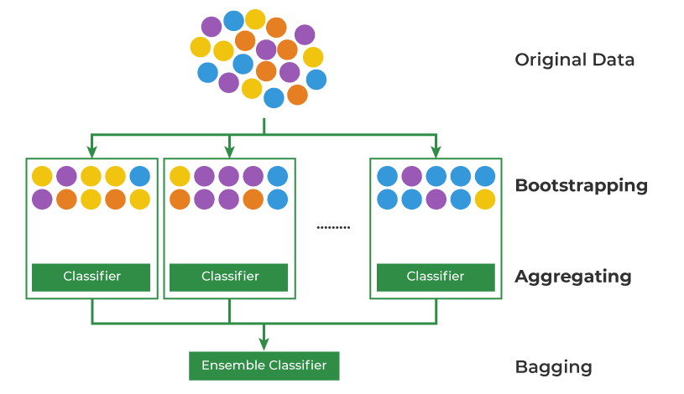

Slide 10
8. Pros
Reduces overfitting
Simple and effective
Parallel execution

Slide 11
9. Cons
No bias reduction
Less interpretable
Higher computation

Slide 12
10. Real-World Applications
Financial risk models
Medical prediction systems
Baseline ensemble models

Slide 13
Summary
Bagging reduces variance by training models independently on bootstrapped data.

Slide 14
GRADIENT BOOSTING
1. What is Gradient Boosting
Gradient Boosting is a sequential ensemble technique where each new model corrects the errors of the previous models using gradient descent.

Slide 15
2. Purpose
To reduce bias and build strong predictive models from weak learners.

Slide 16
3. Why it is Used
Handles complex non-linear patterns
High predictive accuracy
Flexible loss functions

Slide 17
4. How Gradient Boosting Works (Algorithm)
Start with a simple model (initial prediction)
Compute residual errors
Train next model on residuals
Add model to ensemble with learning rate
Repeat sequentially

Slide 18
5. Formula
Fm(x)=Fm−1(x)+η⋅hm(x)
Where:
η= learning rate
hm​ = weak learner

Slide 19
6. Technical Details
Ensemble type: Sequential
Optimizes arbitrary loss functions
Uses gradient descent in function space

Slide 20
7. Parameters
Learning rate
Number of estimators
Tree depth
Loss function

Slide 21
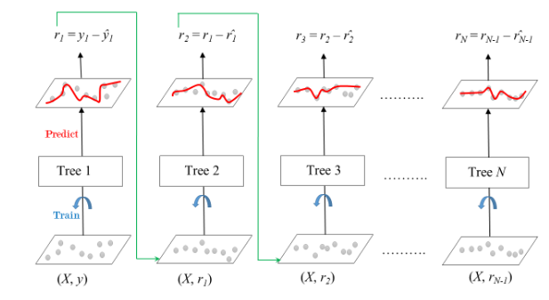

Slide 22
8. Pros
High accuracy
Handles complex data
Custom loss functions

Slide 23
9. Cons
Slow training
Sensitive to hyperparameters
Prone to overfitting if not tuned

Slide 24
10. Real-World Applications
Fraud detection
Ranking systems
Credit scoring

Slide 25
Summary
Gradient Boosting builds models sequentially, each correcting previous mistakes.

Slide 26
ADABOOST (Adaptive Boosting)
1. What is AdaBoost
AdaBoost is a boosting algorithm that focuses on misclassified samples by increasing their weights in subsequent models.

Slide 27
2. Purpose
To convert weak learners into a strong classifier by focusing on hard examples.

Slide 28
3. Why it is Used
Simple boosting algorithm
Strong theoretical foundation
Works well with weak learners

Slide 29
4. How AdaBoost Works (Algorithm)
Assign equal weights to all samples
Train weak learner
Increase weights of misclassified points
Train next learner on reweighted data
Combine learners using weighted voting

Slide 30
5. Formula
Final Model:
F(x)=∑αmhm(x)
Learner Weight:
αm=1/2ln⁡{1−error/error} ​

Slide 31
6. Technical Details
Sequential learning
Sensitive to noisy data
Uses exponential loss

Slide 32
7. Parameters
Number of estimators
Learning rate
Base estimator

Slide 33
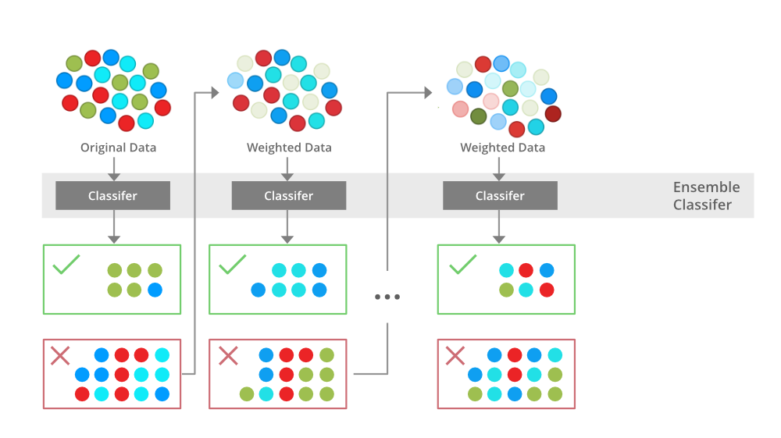

Slide 34
8. Pros
Improves weak models
Simple implementation
Less overfitting than trees

Slide 35
9. Cons
Sensitive to noise & outliers
Poor performance on complex data
Not scalable

Slide 36
10. Real-World Applications
Face detection
Text classification
Early ML systems

Slide 37
Summary
AdaBoost focuses on hard-to-classify samples by increasing their importance.

Slide 38
XGBOOST (Extreme Gradient Boosting)
1. What is XGBoost
XGBoost is an optimized, scalable implementation of Gradient Boosting designed for speed, performance, and regularization.

Slide 39
2. Purpose
To achieve state-of-the-art accuracy on structured/tabular data.

Slide 40
3. Why it is Used
Extremely fast
Built-in regularization
Handles missing values
Winner of many ML competitions

Slide 41
4. How XGBoost Works (Algorithm)
Builds trees sequentially
Uses second-order derivatives (Hessian)
Applies regularization to trees
Prunes trees automatically
Parallelizes tree construction

Slide 42
5. Formula
Objective Function:
Obj=∑l(yi,y^i)+∑Ω(fk)
Regularization:
Ω(f)=γT+1/2λ∑w^2

Slide 43
6. Technical Details
Uses Newton boosting
Supports sparse data
Cache-aware and parallel

Slide 44
7. Parameters
Parameter | Meaning
n_estimators | Number of trees
learning_rate | Step size
max_depth | Tree depth
subsample | Row sampling
colsample_bytree | Feature sampling
lambda, alpha | Regularization

Slide 45
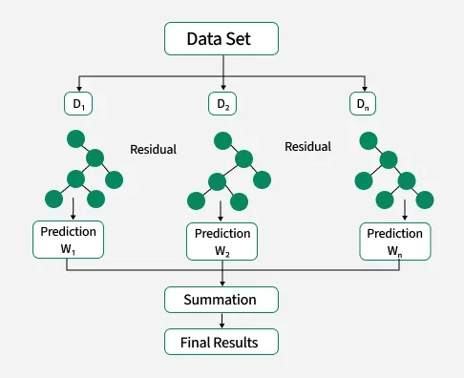

Slide 46
8. Pros
Very high accuracy
Built-in regularization
Handles missing values
Scalable

Slide 47
9. Cons
Complex tuning
Less interpretable
Overkill for small datasets

Slide 48
10. Real-World Applications
Kaggle competitions
Finance risk models
Search ranking
Recommendation systems

Slide 49
Summary
XGBoost is a high-performance, regularized gradient boosting algorithm optimized for speed and accuracy.

Slide 50
FINAL COMPARISON
Method | Bias | Variance | Speed | Overfitting
Bagging | ❌ | ✅ | Fast | Low
AdaBoost | ✅ | ⚠️ | Medium | Medium
Gradient Boosting | ✅ | ⚠️ | Slow | High
XGBoost | ✅ | ✅ | Very Fast | Controlled

